Slide 1

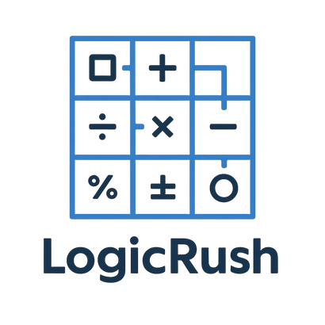

Logic Rush

Slide 2
By Team Logic Legends
Logic Rush is a grid-based math challenge game where every move requires logical thinking.
The player begins at the top-left cell (0,0) and must reach the final cell (N-1, N-1).
Each cell contains a math problem that must be solved correctly to enter it.
Correct answers give points, while mistakes cost lives.

Slide 3
Gameplay Overview
  The game creates a grid depending on the selected difficulty.
  The player can move up, down, left, or right.
  Every cell contains a randomly generated math task.
  A correct answer allows the player to enter the cell and earn points.
  A wrong answer takes away a life and keeps the player in the same position.
  The game is won by reaching the final cell.
  The game is lost when all lives reach zero.

Slide 4
Easy Mode
  Grid size: 4×4
  Lives: 4
  Points per correct answer: 5–10
  Task types: addition and subtraction (numbers from 1 to 20)
  No traps or special cells

Slide 5
Normal Mode
  Grid size: 5×5
  Lives: 3
  Points per correct answer: 8–15
  Task types: addition, subtraction, multiplication (up to 10×10), and integer division
  Special cells:
  Cells that give an extra life
  Bonus cells that award double points

Slide 6
Hard Mode
  Grid size: 7×7
  Lives: 2
  Points per correct answer: 10–25
  Task types:
  All tasks from Normal mode
  Mixed expressions (for example: 13×3 minus 4, or 50 divided by 5 plus 6)
  Square numbers
  Modulo operations
  Trap cells:
  Trigger an additional task
  A wrong answer inside a trap cell costs two lives

Slide 7
Features
  Three difficulty levels with unique rules
  Randomly generated math challenges
  Grid-based movement system
  Lives, points, bonus cells, and traps
  Increasing complexity from Easy to Hard

Slide 8




Our team
Martin Atanasov Jelev
Dimitar Plamenov
Nyagalov
Georgi Ivaylov Nikolov
Plamen Nikolaev Rusev
SCRUM TRAINER
FRONT-END DEVELOPER
BACK-END DEVELOPER
DESIGNER

Slide 9







Technologies used

Slide 10
Thanks for your time!

